Slide 1

YEAR THREE
INFORMATIONAL MEETNG
CLASS 2026

Slide 2
Y3 Info Objectives
Curriculum Overview
Personalized Education Plan (PEP)
Y3 Advisors
MS3 Q & A Panel

Slide 3
Curriculum Overview
Marti Hlafka, MD – Y3 Director
Structure / Calendar
Goals
Coachability
Core Clerkships

Slide 4
BEFORE JULY 8, 2024:
YOU MUST TAKE USMLE STEP 1
BEFORE STARTING CLERKSHIPS
All students are required to record a score on the U.S. Medical Licensing Examination (USMLE) Step 1 before beginning clerkships and must pass the exam to graduate. Students are also required to record a score on the USMLE Step 2 prior to graduation. Course designations pass or fail are included on students' official transcripts.

Slide 5
Year Three Orientation
  SAVE THE DATE:
  Monday, July 8, 2024
  Mandatory (Even those deferring the first clerkship must attend orientation.)
  Core Clerkships begin Monday afternoon July 8, 2024
    Clerkships will provide specific orientation and reporting details

Slide 6
Clerkship Deferral Policy
Core Clerkship Deferrals will be granted only under special circumstances:
  Y2 Educational Enrichment Period resulting in delay of dedicated Step 1 study time
  Emergency/Health situations
  Step 1 failures
  Extracurricular activities, vacations, as well as additional dedicated study time for Step 1 beyond the granted 6 weeks are not valid reasons for deferral.
Students meeting deferral criteria:
  One Core Clerkship:
    Clerkship will be made up during PEP. It must be completed prior to starting any PEP selectives.
  Two Core Clerkships:
    Clerkships will be made up during PEP. They must be completed prior to starting any PEP selectives.
    Students will also be required to complete at least one additional 4 week Intensive Clinical Experience (Sub-Internship) in 4th year. This will add 4 weeks of required elective time such that the student must complete a total of 34 weeks of electives (rather than 30 weeks) for successful completion of 4th year.
  Three Core Clerkships:
    Student must submit a request in writing to the Y3 Student Progress Subcommittee after consultation with the Dean of Students. Student may be required to take a leave of absence.
See the Year Three Policies and Procedures for full details – on the Y3 Core Resources Website

Slide 7
Year Three Structure
Eight Core Clerkships (4 Weeks Each*) Weeks 1 - 34
  Emergency Medicine
  Family & Community Medicine
  *Internal Medicine (6 weeks)
  *Neurology (2 weeks)
  Obstetrics/Gynecology
  Pediatrics
  Psychiatry
  Surgery
Inter-Session Period (3 weeks) Weeks 35,36,37
Personalized Education Plan (PEP) (15 Weeks) Weeks 38-52

Slide 8
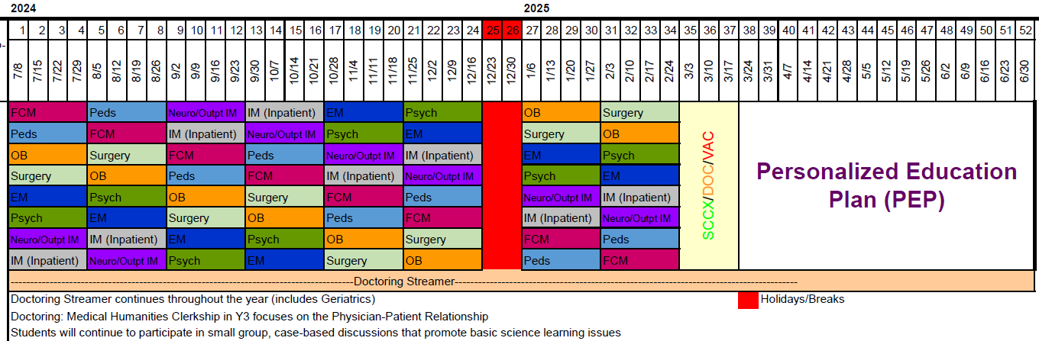
Year Three Calendar

Slide 9
Year Three Curriculum Goals
  Clinical Immersion
  Coaching
    Longitudinal
      Reflection
    Preceptor Based
      Direct observation
      Targeted feedback
Individualized Professional Development

Slide 10

Core Clerkship Skill Development Goals
Clinical Skills Development
H & P skills
DDX and diagnostic justification
Diagnostic and therapeutic plans
Communication & Interpersonal Skills Development
OCPs
Documentation
Healthcare Teams / Systems
Patients, families, caregivers

Slide 11
Core Clerkship Skill Development Goals
Professionalism and Ethical Development
  Patient as person
  Professional image
  Personal limitations
  Recognition of the importance of personal and family roles and the need to balance them with professional demands
  Bias
  Ethical dilemmas

Slide 12
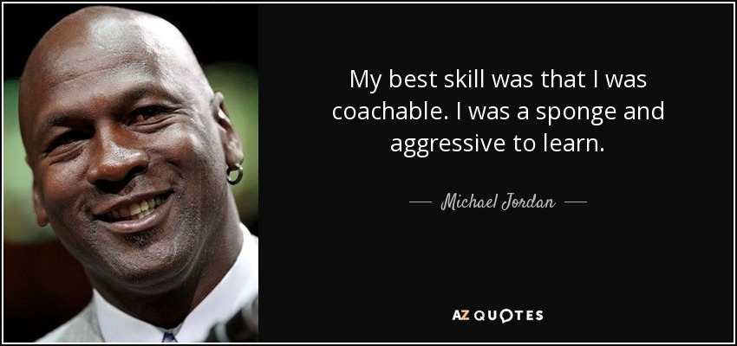

Coaching/Coachability

Slide 13
Core Clerkship Assessment
On the fly feedback
  Based on directly observed skills & behaviors
  Formative feedback and coaching
Skills assessment
Peer evaluations
Professional Growth Assessment (RIME)
Each clerkship weights components differently and will explain evaluation during their orientations.

Slide 14
Knowledge Checks
Expectations / Preparations On The Clerkship (I don’t need to study in Y3. False)
CCC’s (Critical Clinical Competencies) - Required
CPR (Clinical Practice Resources)
Faculty assessment correlates with performance on USMLE Step 2
Number of patients seen/cared for correlates with performance on USMLE Step 2
Practice Step 2 during 3-week intersession (Required)
3 NBME (shelf) exams can be taken during the PEP (Optional)
NBME practice self-assessment exams recommended during core clerkships (medicine, surgery, pediatrics, ob-gyn, psychiatry, neurology) (Optional/Recommended by Students)

Slide 15
Holidays & Vacation / Time Off
Weekend / Holidays (Do not assume you have weekends or holidays off)
  Independence day – July 4, 2024
  Election Day – November 5, 2024 ( Not Confirmed)
  Thanksgiving-Four Day Weekend (Nov 28-29-weekend off)
  Holiday Break-Two Weeks (week 25/26)
    (Dec 23, 2024 – Jan 5, 2025) Return 1/6/2025
  Martin Luther King Day – January 20, 2025
  Juneteenth – June 19, 2025
  Labor Day, Veteran’s Day, Memorial Day all other holidays – At the discretion of the clerkship.
1 week vacation during Intersession Period
Up to 3 Weeks Vacation during PEP
TIME OFF Requests – All absences must be reported / requested
  Acceptable vs unacceptable requests are determined by the clerkship (Hair done, ski trip…)
  Make up time/incomplete clerkships: If make up time cannot be completed during the clerkship, it must be completed during vacation time in the Intersession/PEP.
  Time Off Request Form (new version)

Slide 16
FCM Core Clerkship Scheduling
  Christopher Gleason, MD; Clerkship Director
  Jamie Wallman, MD; Asst. Clerkship Director
  Tara South; Clerkship Coordinator
  CORE / Intersession Scheduling
  Cherie Forsyth, Y3/Y4 Registrar

Slide 17
3 Week Inter-Session Period
Medical Humanities Clerkship (1 week) - No Time Off Requests
  Focus on Professional Identity Formation
Doctoring Geriatric Initiative (1/2 day) – No Time Off Requests
Summative CCX (2 days) – No Time Off Requests
Practice Step 2 CK exam (During CCX week)
Vacation (1 week)

Slide 18
Dates | Group | Curricular components
March 3-7 | 1 and 2 | Doctoring and CCX
 | 3 and 4 | Medical Humanities
 | 5 and 6 | Medical Humanities
March 10-14 | 1 and 2 | Vacation
 | 3 and 4 | Doctoring and CCX
 | 5 and 6 | Vacation
March 17-21 | 1 and 2 | Medical Humanities
 | 3 and 4 | Vacation
 | 5 and 6 | Doctoring and CCX

Slide 19
Personalized Educational Plan (PEP)
Chris Reavis, MS – Y3 Curriculum Coordinator
  Goals
  Selective Course Offerings
  Clerkship Advisors
  Description, Goals and Expectations
  Pairing process

Slide 20
Y3 Personalized Education Plan (PEP)
GOALS
Further development of clinical skills and clinical reasoning, especially those identified during the core rotations as areas for improvement
Deep dive into clinical areas of personal interest and discovery
Opportunity to develop skills in other areas as a well rounded physician.
This is further CLINICAL experience, NOT research or other
PEP remains part of third year, it is NOT early start to fourth year

Slide 21
Y3 PEP Structure
15 weeks of the PEP if no Deferral or Make Up
Selective Courses (Approximately 85 Course Options)
Longitudinal Experiences
Individually Designed Selectives (IDS)
No Off-Campus Selectives in Year 3 (FCM/Affiliates)
Y4 Elective Credit Not Awarded In Y3

Slide 22
Individually-Designed Selectives
The Individually-Designed Selective (IDS) option is available to students who are interested in a course or topic for which a regular selective does not exist
IDS will be considered only under special circumstances, and must be with SIU Faculty and Advisor Approval
For further information regarding IDS opportunities, please refer to the Y3 Policies and Procedures and talk with your Advisor, Chris Reavis or Cherie Forsyth.
Must be clinically oriented (No Research or Off Campus)

Slide 23
PEP Orientation Selectives Courses in Year Three
PEP Orientation will be held in early January
  More Specific details will be shared at that time.
PEP Enrollment begins in late February

Slide 24
Y3 Advisor
Requirements

Slide 25
Who They Are?
What their function is?
How to get the most out of your time with the Clerkship Advisor?

Slide 26
Questions / Assistance
Martha Hlafka, MD – Y3 Director
Chris Reavis, MS – Y2/Y3/Y4 Curriculum Coordinator
Cherie Forsyth – Y3/Y4 Registrar
Debra Klamen, MD, MHPE - Senior Associate Dean for Education and Curriculum
Susan Hingle, MD – Medical Humanities Director
Alex Hopkins, PhD – Y3 Medical Humanities Clerkship Director
Gary Rull, MD – Doctoring

Slide 27
Student Panel

